Slide 1



DPAS
DISEASE PRE ANALYSIS SYSTEM
BY
Akshansh Mahajan(2110993756)
Anmol Verma(2110993762)
Jaspreet Singh(2110993802)

Slide 2


CONTENT
1
2
3
4
5
Introduction
Objective
Prerequisite
Explanation
Conclusion

Slide 3


WHAT
IS
DPAS?

Slide 4


INTRODUCTION
The DPAS(Disease Pre-Analysis System) is an advanced model based on the K-Nearest Neighbors (KNN) algorithm designed to efficiently detect diseases. It leverages machine-learning techniques to analyze medical data and provide accurate predictions regarding the presence of specific diseases. By incorporating a KNN approach, this system can identify patterns and similarities within a dataset, allowing for effective disease classification and early detection. This introduction provides an overview of the Disease Pre-Analysis System, highlighting its purpose and the benefits it offers in improving healthcare outcomes.

Slide 5

OBJECTIVE
01
The first objective of the Disease Pre-Analysis System is to enhance the accuracy of disease detection. By utilizing the KNN model and analyzing a diverse range of medical data, the system aims to identify patterns and similarities that may not be easily noticeable to healthcare professionals.
02
Facilitate Early Intervention and Preventive Measures Another crucial objective of the Disease Pre-Analysis System is to facilitate early intervention and preventive measures. By detecting diseases at an early stage, the system empowers healthcare professionals to implement timely interventions and preventive strategies.

Slide 6



PREREQUISITE
PANDAS
NUMPY
SKLEARN
LIBRARIES USED:
PYTHON
JUPYTER
NOTEBOOK
MATPLOTLIB
SEABORN

Slide 7

EXPLANATION
In our model, users select symptoms, and the Disease Pre-Analysis System predicts the disease they might be suffering from. This is done using the K-Nearest Neighbors algorithm. Based on the majority class of these K nearest neighbors, the system predicts the disease that the user might be suffering from. For example, if most of the nearest neighbors have been diagnosed with "Influenza," the system will predict that the user might have Influenza as well. It provides users with preliminary insights, but consulting a healthcare professional is essential for a formal diagnosis and proper treatment.

Slide 8
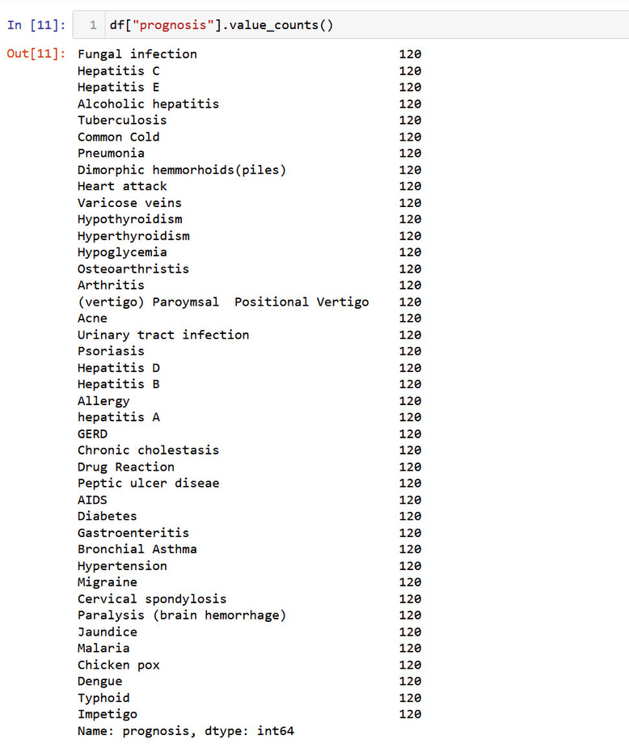
EXPLANATION
Ranging from fungal infections to migraine, we can diagnose the following:

Slide 9
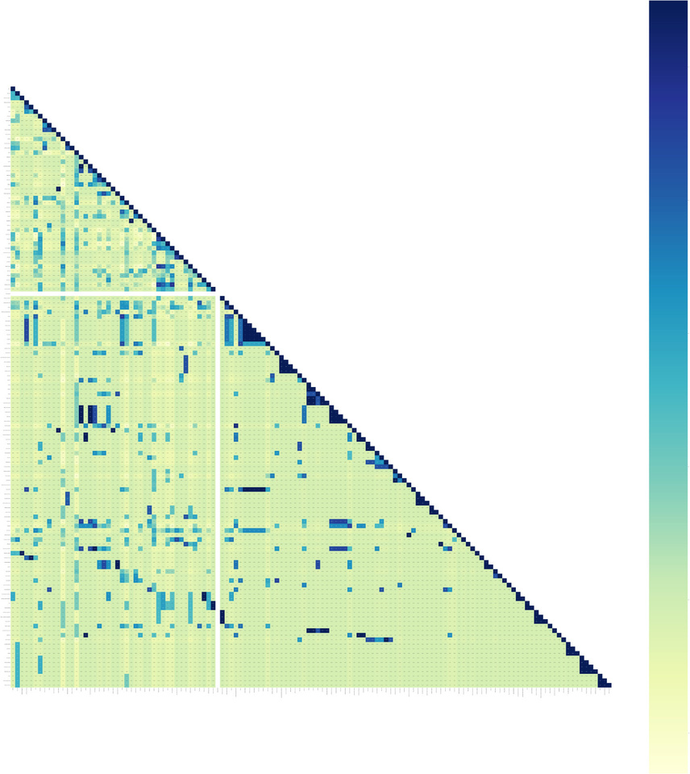
EXPLANATION
A correlation graph, also known as a scatter plot, is a visual representation of the relationship between two variables. It displays data points as individual dots on a Cartesian plane, with one variable plotted on the x-axis and the other on the y-axis. The pattern formed by the dots can indicate the strength and direction of the correlation between the variables. A positive correlation is shown by an upward-sloping pattern, while a negative correlation is represented by a downward-sloping pattern. The closer the data points are to a straight line, the stronger the correlation. Correlation graphs are useful for identifying relationships and trends in data, but they do not indicate causation.

Slide 10
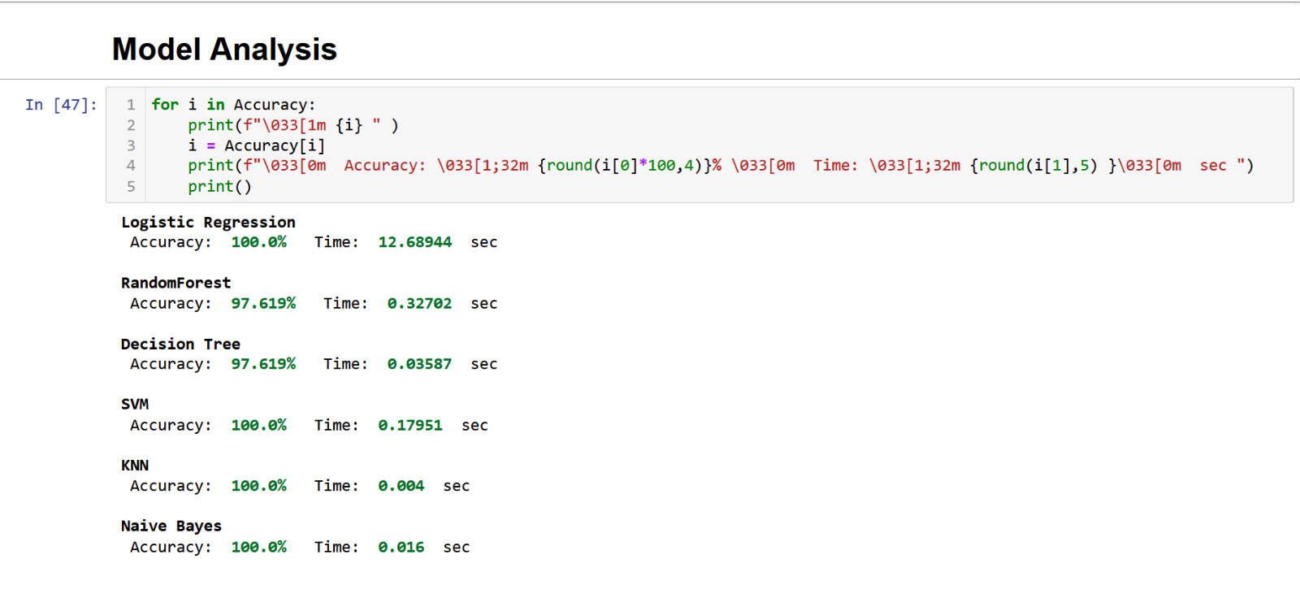
EXPLANATION
These are the various models with their accuracies:

Slide 11
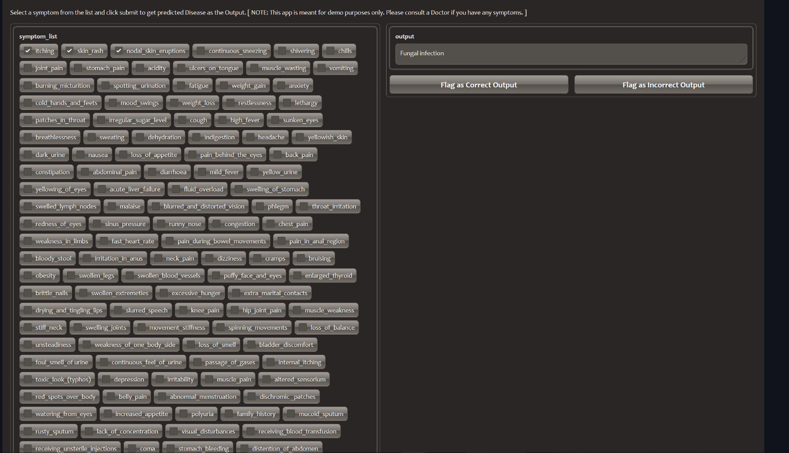

EXPLANATION
This is deployment of the model:
Users can flag if the output is correct or not.

Slide 12

CONCLUSION
The Disease Pre-Analysis System, using the K-Nearest Neighbors algorithm, provides a valuable tool for detecting diseases based on user-selected symptoms. It improves disease detection accuracy and enables early intervention. While it offers preliminary insights, consulting healthcare professionals remains crucial. The system has the potential to enhance healthcare outcomes and efficiency by leveraging machine learning and comprehensive medical data. As technology advances, such intelligent systems can contribute to timely diagnoses and better overall healthcare outcomes.

